Slide 1
ENTITY-LEVEL SENTIMENT ANALYSIS ON YOUTUBE COMMENTS
TASK: to classify the sentiment of the comment as Positive,
Negative,
or Neutral, with messages irrelevant to the entity also
categorized as Neutral.
Oluwole Ajakaye

Slide 2
Project Objective:
The objective of this internship project is to perform entity-level sentiment analysis on YouTube comments using provided training and validation datasets. Given a comment and a specified entity (e.g., video ID or creator name), the task is to classify the sentiment of the comment as Positive, Negative, or Neutral, with messages irrelevant to the entity also categorized as Neutral.

Slide 3
Data Collection: Two datasets given in csv format
Twitter_training dataset
Twitter_validation dataset

Slide 4
Data Exploration:
Libraries needed:
import pandas as pd
import numpy as np
import seaborn as sns
cont’d

Slide 5
twitter_training data
Load the training or validation datasets with custom column names
column_names = ["Tweet ID", "Borderlands", "Sentiment", "Tweet Content"]
training_data = pd.read_csv ("twitter_training.csv", names=column_names,
header=None)
Display the column names
print(training_data.columns)
Display the first few rows of the dataset
print(training_data.head())
Display basic information about the dataset
print(training_data.info())
Display the distribution of sentiment classes
print(training_data['Sentiment'].value_counts())
Display the first 5 rows of the dataset
training_data.head()
Display the number of rows and columns of the dataset
training_data.shape
Checking missing values
training_data.isnull().sum()
NOTE: Same steps and procedures are followed for the twitter_validation data.
twitter_validation data

Slide 6
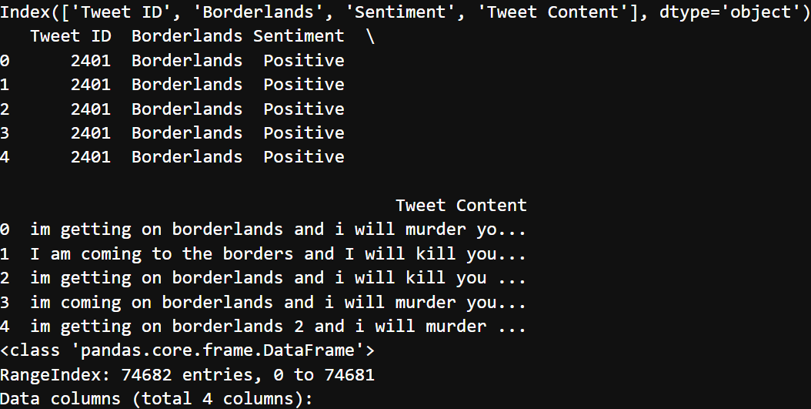
output:

Slide 7
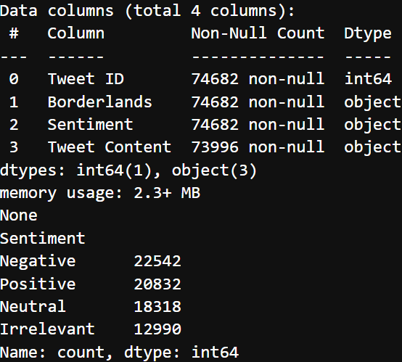
output cont’d

Slide 8
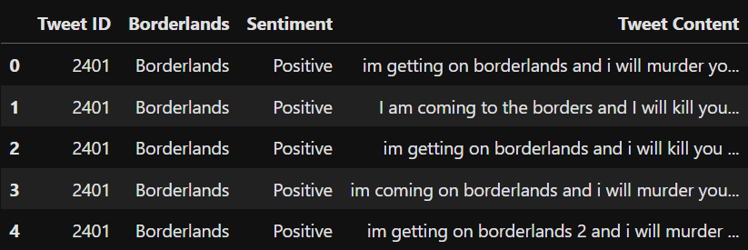
output cont’d

Slide 9
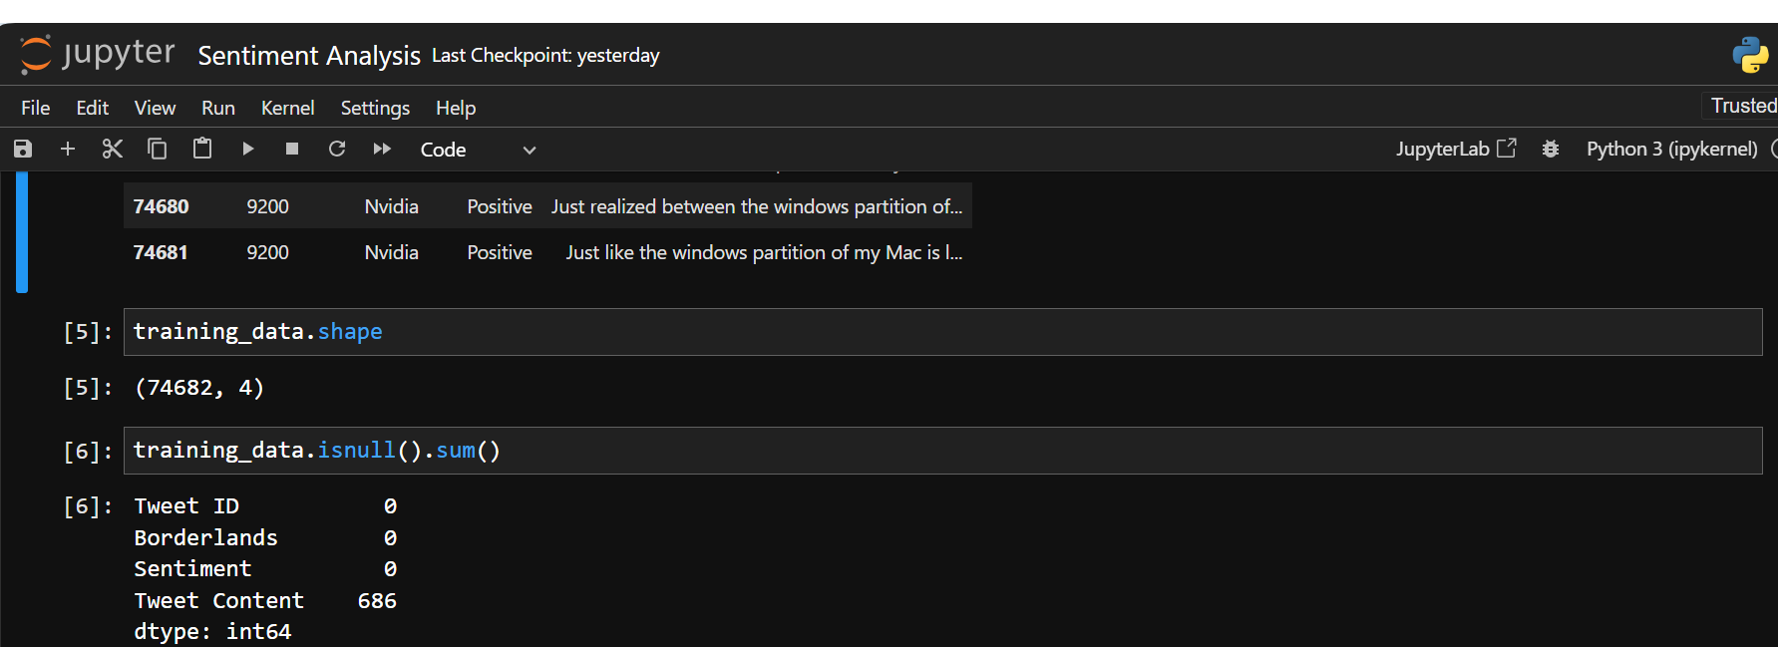
output cont’d

Slide 10
Data Preprocessing:
This is a step to clean the text data to handle noise, such as special characters, URLs, emojis, and missing or erroneous data, while retaining relevant textual information.
Load the training dataset with custom column names
Drop duplicate rows
Handle missing values/Drop rows with any missing values
Drop rows with duplicate values
Clean text data (Remove special characters, URLs, and emojis)
Display the first few rows of the cleaned dataset
Print pre-process data (training_data.head())

Slide 11
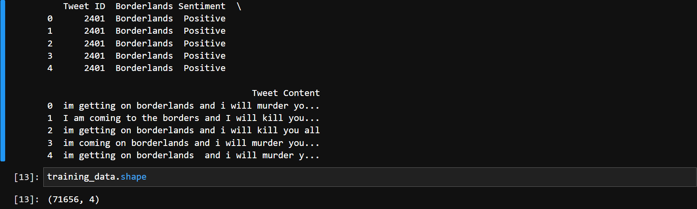
Output of Preprocessing:
For twitter_training data

Slide 12
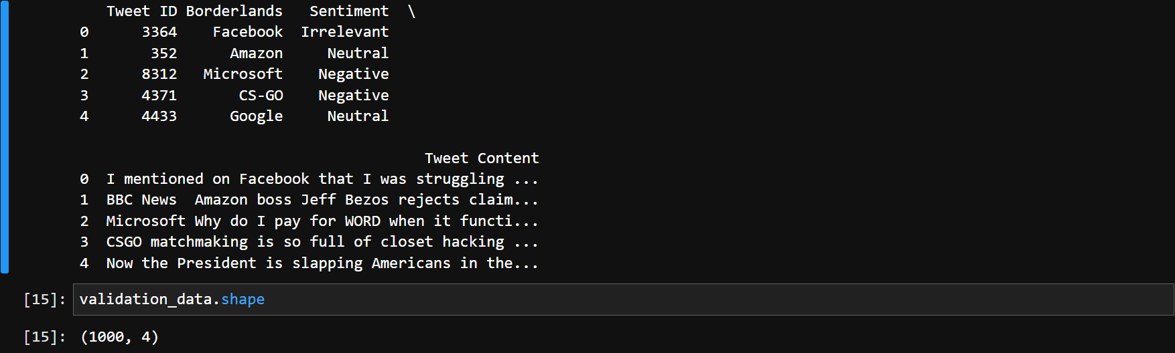
Output of Preprocessing cont’d
For twitter_validation data

Slide 13
Model Development:
To perform sentiment classification using TF-IDF (Term Frequency-Inverse Document Frequency), we need to vectorize the preprocessed text data. We'll use the TfidfVectorizer from scikit-learn to convert the text into numerical features. Here are the steps to do it:
Perform sentiment classification using TF-IDF (Term Frequency-Inverse Document Frequency), we need to vectorize the preprocessed text data. We'll use the TfidfVectorizer from scikit-learn to convert the text into numerical features. Here's how you can do it:
Initialize a TfidfVectorizer with a maximum of 5000 features. (This can be adjusted based on the size of the dataset and the complexity of the text)
Fit and transform the training data using fit_transform.
Transform the validation data using transform. It's important to note that same features learned from the training data are used to transform the validation data.
Finally, display the shape of the TF-IDF matrices to verify the dimensionality of the transformed data.

Slide 14
Model Development cont’d
Display the shape of the TF-IDF matrices
This process converts the textual data into a numerical representation suitable for training machine learning models.

Slide 15
The code:
from sklearn.feature_extraction.text import TfidfVectorizer
# Initialize the TfidfVectorizer
tfidf_vectorizer = TfidfVectorizer(max_features=5000) # Adjust max_features as needed
# Fit and transform the training data
X_train_tfidf = tfidf_vectorizer.fit_transform(training_data['Tweet Content'].astype(str))
# Transform the validation data (using the same vocabulary as the training data)
X_val_tfidf = tfidf_vectorizer.transform(validation_data['Tweet Content'].astype(str))
# Display the shape of the TF-IDF matrices
print("Shape of TF-IDF matrix for training data:", X_train_tfidf.shape)
print("Shape of TF-IDF matrix for validation data:", X_val_tfidf.shape)

Slide 16
Output of Model Development:

Slide 17
Output of Model Development cont’d
The output indicates that the TF-IDF matrices have been successfully created for both the training and validation data, with a shape of (1000, 5000). This means that there are 1000 samples in each dataset, and each sample has been represented using a TF-IDF vector with 5000 features.
Note, the shape of the TF-IDF matrix (1000, 5000) represents the transformed representation of the text data after applying TF-IDF vectorization. It's different from the shape of the original datasets training_data.shape and validation_data.shape, which represent the number of rows and columns in the datasets before any preprocessing or feature extraction.

Slide 18
training machine learning models for sentiment analysis
Now that the TF-IDF matrices are ready for both the training and validation data, we can proceed with training the sentiment classification model with top-1 classification accuracy being the primary metric.
Two model selections are considered:
TF-IDF Vectorizer with ML Algorithm:
In this approach, we first convert text data into numerical vectors using techniques like TF-IDF (Term Frequency-Inverse Document Frequency).
These numerical vectors represent the features of the text data.
Then, we use traditional machine learning algorithms such as Logistic Regression, Random Forest, or Support Vector Machines to train a classifier using these numerical features.
The model learns patterns in the data and makes predictions based on these patterns.

Slide 19
Machine Learning Model cont’d
LSTM with TensorFlow Keras API:
In this approach, we use deep learning techniques, specifically Long Short-Term Memory (LSTM) neural networks.
LSTM networks are a type of recurrent neural network (RNN) architecture designed to work well with sequence data like text.
Instead of manually engineering features like with TF-IDF, the model learns to extract relevant features from the text data during training.
The LSTM model can capture long-term dependencies in sequences, making it well-suited for tasks like sentiment analysis where the order of words matters.

Slide 20
TF-IDF Vectorizer with ML Algorithm:
#Libraries needed
from sklearn.feature_extraction.text import TfidfVectorizer
from sklearn.model_selection import train_test_split
from sklearn.metrics import accuracy_score
from sklearn.linear_model import LogisticRegression
# Initialize the TfidfVectorizer
tfidf_vectorizer = TfidfVectorizer(max_features=5000) # Adjust max_features as needed
# Fit and transform the training data
X_train_tfidf = tfidf_vectorizer.fit_transform(training_data['Tweet Content'].astype(str))

Slide 21
TF-IDF Vectorizer with ML Algorithm cont’d
# Transform the validation data (using the same vocabulary as the training data)
X_val_tfidf = tfidf_vectorizer.transform(validation_data['Tweet Content'].astype(str))
# Define the target labels
y_train = training_data['Sentiment']
y_val = validation_data['Sentiment']
# Initialize and train the classifier (Logistic Regression in this case)
classifier = LogisticRegression()
classifier.fit(X_train_tfidf, y_train)
# Predict on validation data
y_pred = classifier.predict(X_val_tfidf)

Slide 22
TF-IDF Vectorizer with ML Algorithm cont’d
# Evaluate model performance
acuracy = accuracy_score(y_val, y_pred)
print("Top-1 Classification Accuracy:", accuracy)
Output:
TF-IDF vectorizer with the Logistic Regression model is giving a significant accuracy of (Top-1 Classification Accuracy: 0.912)

Slide 23
LSTM with TensorFlow Keras API:
#Libraries needed
import tensorflow as tf
from tensorflow.keras.models import Sequential
from tensorflow.keras.layers import Embedding, LSTM, Dense, Dropout
from sklearn.preprocessing import LabelEncoder
from sklearn.metrics import accuracy_score
from sklearn.utils.class_weight import compute_class_weight

Slide 24
LSTM with TensorFlow Keras API cont’d
# Encode sentiment labels to numerical format
label_encoder = LabelEncoder()
training_data['Sentiment_Encoded'] = label_encoder.fit_transform(training_data['Sentiment'])
validation_data['Sentiment_Encoded'] = label_encoder.transform(validation_data['Sentiment'])
# Define LSTM model architecture
vocab_size = 5000 # Adjust as needed based on TfidfVectorizer max_features
embedding_dim = 100
max_sequence_length = X_train_tfidf.shape[1] # Max sequence length from TF-IDFmatrices
num_classes = 4 # Positive, Negative, Neutral, Irrelevant
lstm_units = 128 # Number of LSTM units, adjust as needed

Slide 25
LSTM with TensorFlow Keras API cont’d
model = Sequential()
model.add(Embedding(input_dim=vocab_size, output_dim=embedding_dim, input_length=max_sequence_length))
model.add(LSTM(units=lstm_units, dropout=0.2, recurrent_dropout=0.2)) #Add dropout for regularization
model.add(Dense(units=num_classes, activation='softmax'))
# Compile the model
model.compile(optimizer='adam', loss='sparse_categorical_crossentropy', metrics=['accuracy'])
# Compute class weights to handle class imbalance
class_weights = compute_class_weight('balanced',classes=np.unique(training_data['Sentiment_Encoded']), y=training_data['Sentiment_Encoded'])

Slide 26
LSTM with TensorFlow Keras API cont’d
# Train the model
history = model.fit(X_train_tfidf, training_data['Sentiment_Encoded'], epochs=10, batch_size=64,
validation_data=(X_val_tfidf, validation_data['Sentiment_Encoded']),
class_weight=dict(enumerate(class_weights))) # Pass class weights
# Predict probabilities for each class
y_pred_probs = model.predict(X_val_tfidf)
# Get the predicted class for each sample
y_pred = np.argmax(y_pred_probs, axis=1)
# Convert predicted labels back to original sentiment labels
y_pred_labels = label_encoder.inverse_transform(y_pred)
# Evaluate model performance
accuracy = accuracy_score(validation_data['Sentiment'], y_pred_labels)
print("Top-1 Classification Accuracy:", accuracy)

Slide 27
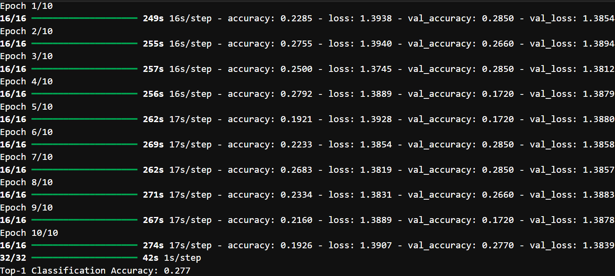
LSTM with TensorFlow Keras API (Output)

Slide 28
The performance of two different models for entity-level sentiment analysis on YouTube comments:
1) Model Development with TfidfVectorizer
Top-1 Classification Accuracy: 91.2%
Interpretation/Application:
This model achieved a high accuracy of 91.2% in classifying YouTube comments' sentiment towards specified entities using TfidfVectorizer for feature extraction and logistic regression for classification.
The high accuracy suggests that the model is effective in discerning sentiment in YouTube comments and can be utilized to analyze audience reception towards specific entities on the platform.
Content creators and marketers can leverage this model to gain insights into audience sentiment, helping them tailor their content strategies to enhance engagement and satisfaction.

Slide 29
The performance of two different models for entity-level sentiment analysis on YouTube comments:
2) Model Development with LSTM (TensorFlow):
Top-1 Classification Accuracy: 27.7%
Interpretation/Application:
This model achieved a lower accuracy of 27.7% in classifying sentiment using LSTM neural networks, indicating that it may not perform as well as the TfidfVectorizer-based model for entity-level sentiment analysis on YouTube comments.
The lower accuracy suggests that the LSTM model may not effectively capture the complex relationships and nuances present in YouTube comments compared to the TfidfVectorizer-based approach.
While LSTM models are capable of capturing sequential dependencies in text data, their performance may vary depending on factors such as dataset size, complexity of language, and model hyperparameters.
In summary, the TfidfVectorizer-based model outperformed the LSTM model in terms of classification accuracy for entity-level sentiment analysis on YouTube comments. Content creators and marketers can use the TfidfVectorizer-based model to gain valuable insights into audience sentiment and tailor their strategies accordingly to enhance engagement and satisfaction on the platform.

Slide 30
Sentiment Class Distribution:
# Training Dataset
# Group the training data by 'Borderlands' and 'Sentiment' columns
training_sentiment_distribution =training_data.groupby(['Borderlands','Sentiment']).size().unstack(fill_value=0)
# Calculate the total count of each sentiment class for each entity
training_sentiment_distribution['Total'] = training_sentiment_distribution.sum(axis=1)
# Calculate the percentage of each sentiment class for each entity training_sentiment_distribution_percentage = training_sentiment_distribution.div(training_sentiment_distribution['Total'], axis=0) * 100
# Display the sentiment distribution for the training data
print("Sentiment Distribution for Training Data:")print(training_sentiment_distribution_percentage)

Slide 31
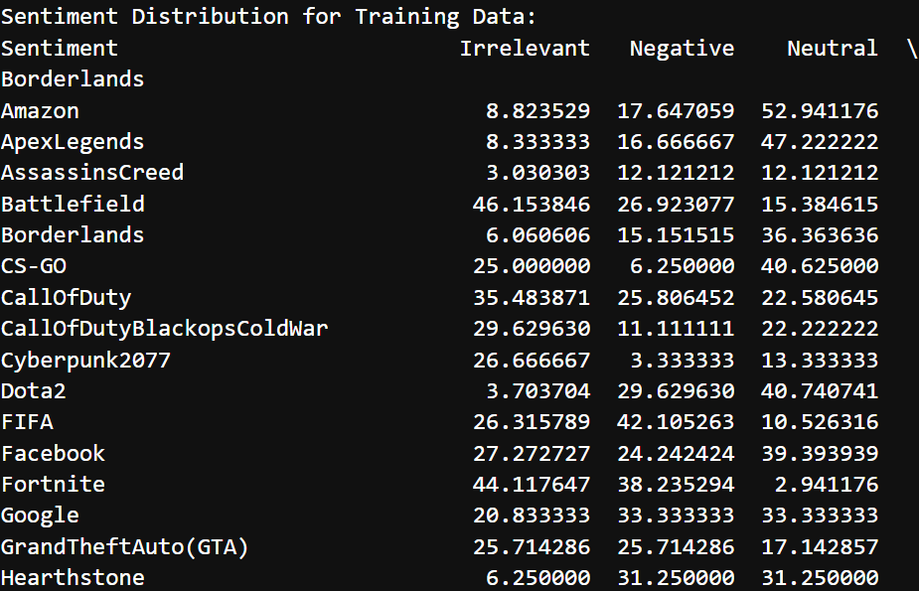
Sentiment Class Distribution cont’d

Slide 32
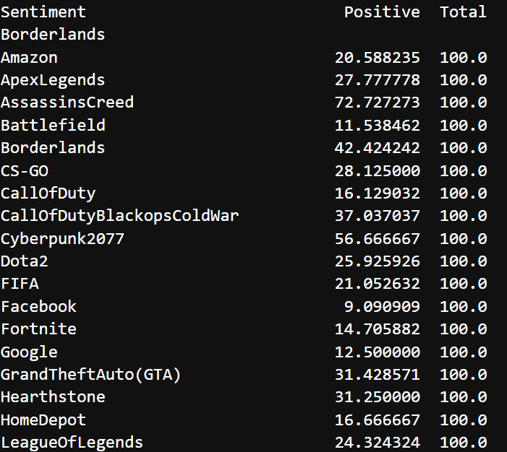
Sentiment Class Distribution cont’d

Slide 33
VISUALIZATION DASHBOARD Sentiment Distribution by Entity:
#Sentiment Distribution by Entity:
# Get unique entities from the 'Borderlands' column
entities = training_data['Borderlands'].unique() # or validation_data if you're working with that DataFrame
# Define a colour palette with enough colours for each entity
colours = sns.colour_palette('husl', n_colours=len(entities))
# Plot sentiment distribution for each entity
plt.figure(figsize=(12, 6))
for i, entity in enumerate(entities):
entity_sentiment_counts = training_data[training_data['Borderlands'] == entity]['Sentiment'].value_counts()
entity_sentiment_counts.plot(kind='bar', alpha=0.7, label=entity, color=colors[i])
# Display legend at the extreme right
plt.legend(bbox_to_anchor=(1.05, 1), loc='upper left')
plt.title('Sentiment Distribution by Entity')
plt.xlabel('Sentiment')
plt.ylabel('Count')
plt.show()

Slide 34
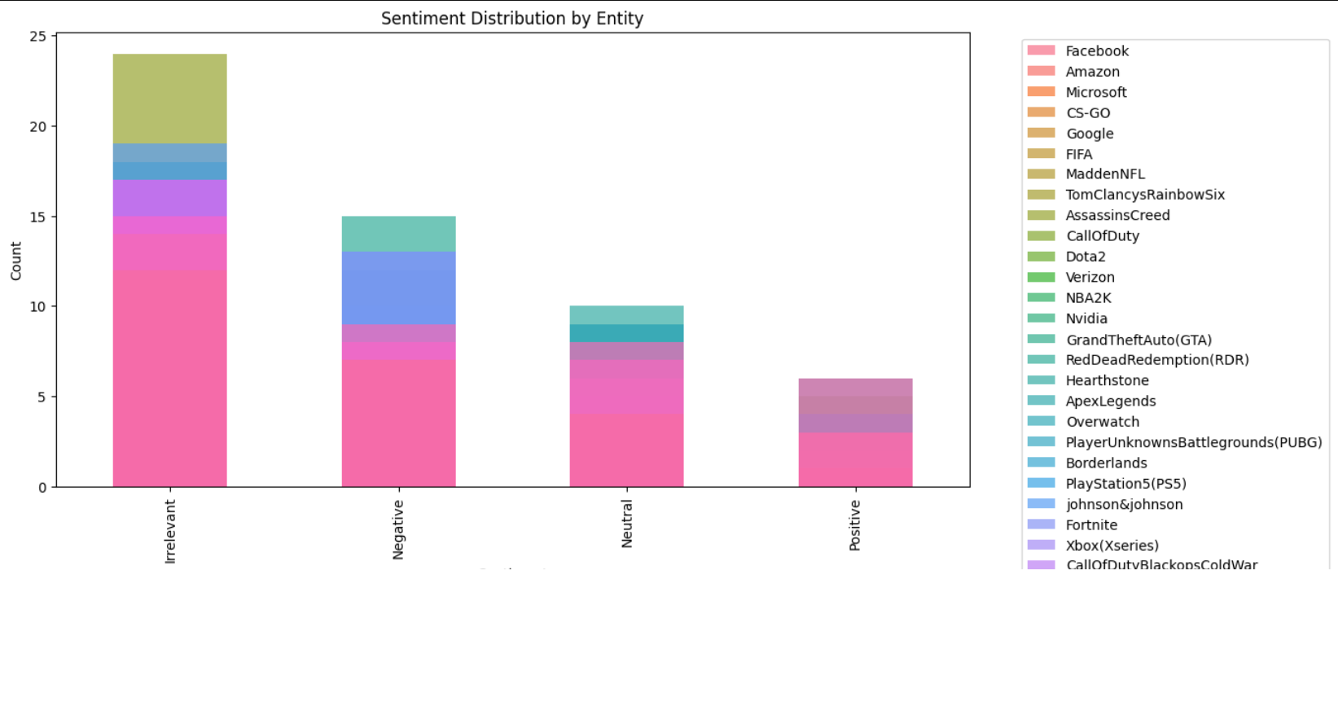
VISUALIZATION DASHBOARD Sentiment Distribution by Entity:

Slide 35
VISUALIZATION DASHBOARD Comparison of Sentiment Analysis Methods:
# Plot comparison of methods
# Define the methods and their accuracy scores
methods = ['TF-IDF + Logistic Regression', 'LSTM + TensorFlow']
accuracy_scores = [0.912, 0.285] # Placeholder accuracy score for LSTM
# Plot comparison of methods
plt.figure(figsize=(8, 6))
plt.bar(methods, accuracy_scores, color=['blue', 'orange'])
plt.title('Comparison of Sentiment Analysis Methods')
plt.xlabel('Method')
plt.ylabel('Accuracy')
plt.ylim(0, 1) # Set y-axis limit to match the range of accuracy scores
plt.show()

Slide 36
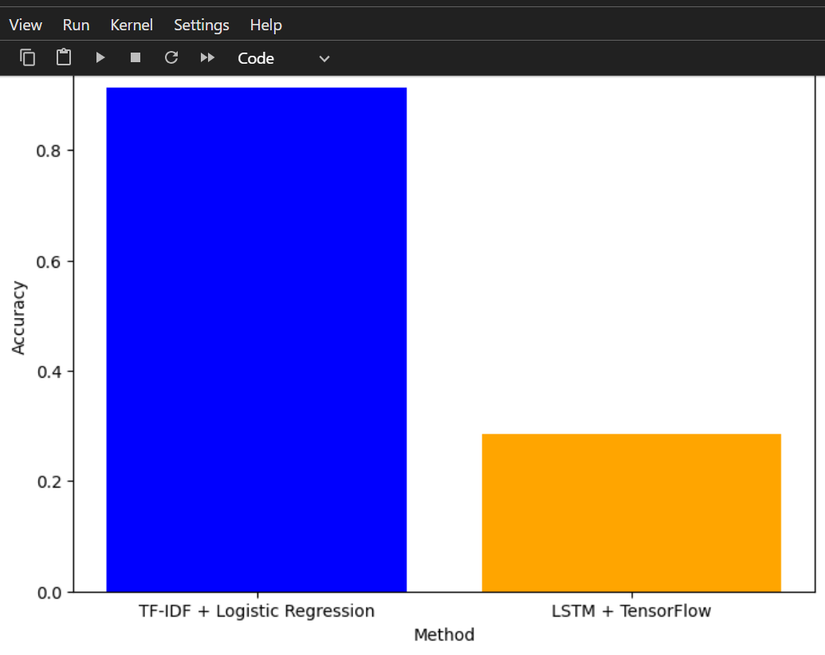
VISUALIZATION DASHBOARD Comparison of Sentiment Analysis Methods:

Slide 37
VISUALIZATION DASHBOARD Word Clouds:
# Word Clouds:
from wordcloud import WordCloud
# Generate word clouds
positive_words = ' '.join(training_data[training_data['Sentiment'] == 'Positive']['Tweet Content'])
negative_words = ' '.join(training_data[training_data['Sentiment'] == 'Negative']['Tweet Content'])
neutral_words = ' '.join(training_data[training_data['Sentiment'] == 'Neutral']['Tweet Content'])
irrelevant_words = ' '.join(training_data[training_data['Sentiment'] == 'Irrelevant']['Tweet Content'])
wordcloud_positive = WordCloud(width=800, height=400).generate(positive_words)
wordcloud_negative = WordCloud(width=800, height=400).generate(negative_words)
wordcloud_neutral = WordCloud(width=800, height=400).generate(neutral_words)
wordcloud_irrelevant = WordCloud(width=800, height=400).generate(irrelevant_words)

Slide 38
VISUALIZATION DASHBOARD Word Clouds cont’d
# Plot word clouds
plt.figure(figsize=(20, 10))
plt.subplot(221)
plt.imshow(wordcloud_positive, interpolation='bilinear')
plt.title('Positive Sentiment Word Cloud')
plt.axis('off')
plt.subplot(222)
plt.imshow(wordcloud_negative, interpolation='bilinear')
plt.title('Negative Sentiment Word Cloud')
plt.axis('off')
plt.subplot(223)

Slide 39
VISUALIZATION DASHBOARD Word Clouds cont’d
plt.imshow(wordcloud_neutral, interpolation='bilinear')
plt.title('Neutral Sentiment Word Cloud')
plt.axis('off')
plt.subplot(224)
plt.imshow(wordcloud_irrelevant, interpolation='bilinear')
plt.title('Irrelevant Sentiment Word Cloud')
plt.axis('off')
plt.show()

Slide 40
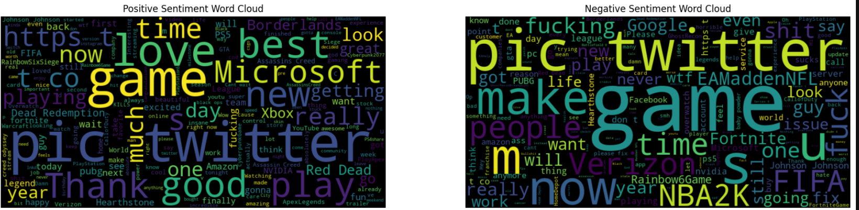
VISUALIZATION DASHBOARD Word Clouds cont’d

Slide 41
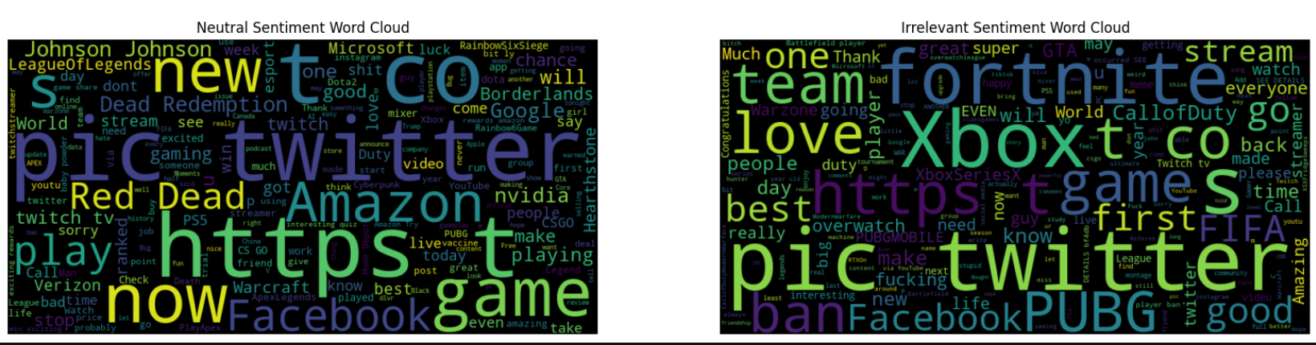
VISUALIZATION DASHBOARD Word Clouds cont’d

Slide 42
VISUALIZATION DASHBOARD Confusion Matrix:
# Confusion Matrix
# Predict on validation data
from sklearn.metrics import confusion_matrix, accuracy_score, precision_score, recall_score, f1_score
import seaborn as sns
import matplotlib.pyplot as plt
from sklearn.preprocessing import LabelEncoder
# Convert sentiment labels to numerical format
sentiments = ['Irrelevant', 'Neutral', 'Negative', 'Positive']
label_encoder = LabelEncoder()
label_encoder.fit(sentiments)
y_true_encoded = label_encoder.transform(validation_data['Sentiment'])
# Encode predicted labels using the same label encoder
y_pred_encoded = label_encoder.transform(y_pred_labels)
# Generate confusion matrix
conf_matrix = confusion_matrix(y_true_encoded, y_pred_encoded)

Slide 43
VISUALIZATION DASHBOARD Confusion Matrix cont’d
# Calculate metrics
accuracy = accuracy_score(y_true_encoded, y_pred_encoded)
precision = precision_score(y_true_encoded, y_pred_encoded, average='weighted')
recall = recall_score(y_true_encoded, y_pred_encoded, average='weighted')
f1 = f1_score(y_true_encoded, y_pred_encoded, average='weighted')
# Plot confusion matrix
plt.figure(figsize=(8, 6))
sns.heatmap(conf_matrix, annot=True, fmt='d', cmap='Blues', cbar=False)
plt.title('Confusion Matrix')
plt.xlabel('Predicted Label')
plt.ylabel('True Label')

Slide 44
VISUALIZATION DASHBOARD Confusion Matrix cont’d
# Add TP, TN, FP, FN counts to the plot
for i in range(len(sentiments)):
for j in range(len(sentiments)):
plt.text(j + 0.5, i + 0.5, str(conf_matrix[i, j]), ha='center', va='center', color='red' if i != j else 'white')
plt.show()
print("Accuracy:", accuracy)
print("Precision:", precision)
print("Recall:", recall)
print("F1-score:", f1)

Slide 45
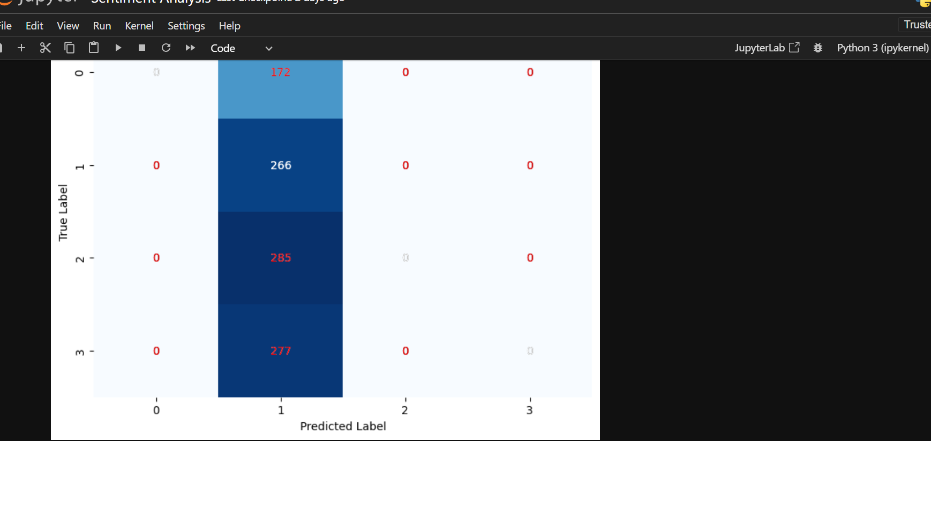
VISUALIZATION DASHBOARD Confusion Matrix cont’d

Slide 46
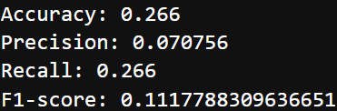
VISUALIZATION DASHBOARD Confusion Matrix cont’d

Slide 47
VISUALIZATION DASHBOARD Confusion Matrix cont’d
The aim of the confusion matrix is to provide a visual representation of the performance of a classification model. It helps us understand how well the model is performing in terms of making predictions on the validation dataset. In the confusion matrix, each row represents the actual class, while each column represents the predicted class. The cells of the matrix show the count (or percentage) of instances that fall into each category.
Interpretation:
True Positives (TP): These are the instances where the model correctly predicts the positive class (e.g., Positive sentiment).
True Negatives (TN): These are the instances where the model correctly predicts the negative class (e.g., Irrelevant sentiment).
False Positives (FP): These are the instances where the model incorrectly predicts the positive class (e.g., Predicted Positive, but actually Negative or Neutral).
False Negatives (FN): These are the instances where the model incorrectly predicts the negative class (e.g., Predicted Negative, but actually Positive or Neutral).

Slide 48
VISUALIZATION DASHBOARD Distribution of Text Length
# Distribution of Text Length:
# Calculate text length
training_data['Text Length'] = training_data['Tweet Content'].apply(lambda x: len(x.split()))
validation_data['Text Length'] = validation_data['Tweet Content'].apply(lambda x: len(x.split()))
# Plot text length distribution by sentiment
plt.figure(figsize=(8, 4))
sns.boxplot(data=training_data, x='Sentiment', y='Text Length')
plt.title('Distribution of Text Length by Sentiment')
plt.xlabel('Sentiment')
plt.ylabel('Text Length')
plt.show()

Slide 49
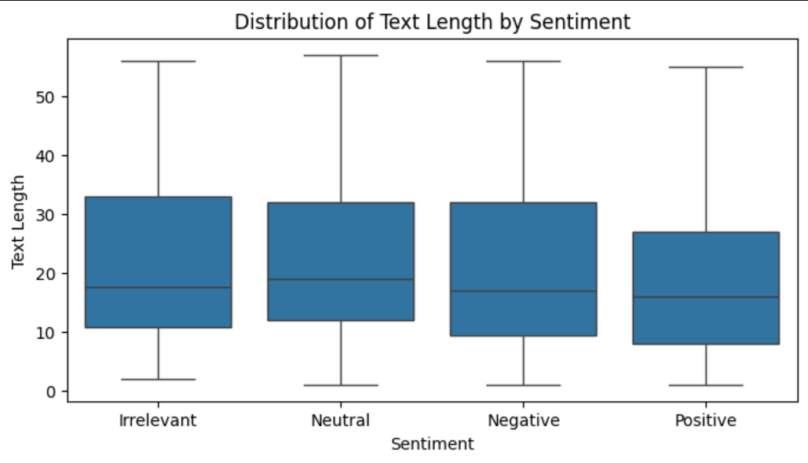
VISUALIZATION DASHBOARD Distribution of Text Length

Slide 50
VISUALIZATION DASHBOARD Distribution of Text Length
# Entity Sentiment Trends:
from sklearn.preprocessing import LabelEncoder
# Encode sentiment labels to numerical format
label_encoder = LabelEncoder()
training_data['Sentiment_Encoded'] = label_encoder.fit_transform(training_data['Sentiment'])
# Get unique entities from the 'Borderlands' column
entities = training_data['Borderlands'].unique()
# Plot entity sentiment trends
plt.figure(figsize=(12, 6))
# Reverse the order of entities
entities = entities[::-1]

Slide 51
VISUALIZATION DASHBOARD Distribution of Text Length
for entity in entities:
entity_sentiment_mean = training_data[training_data['Borderlands'] == entity]['Sentiment_Encoded'].mean()
plt.bar(entity, entity_sentiment_mean, label=entity)
plt.title('Mean Entity Sentiment')
plt.xlabel('Entity')
plt.ylabel('Mean Sentiment')
# Rotate labels on X-axis vertically
plt.xticks(rotation=90)
plt.legend(bbox_to_anchor=(1.05, 1), loc='upper left')
plt.tight_layout() # Adjust layout to prevent overlap
plt.show()

Slide 52
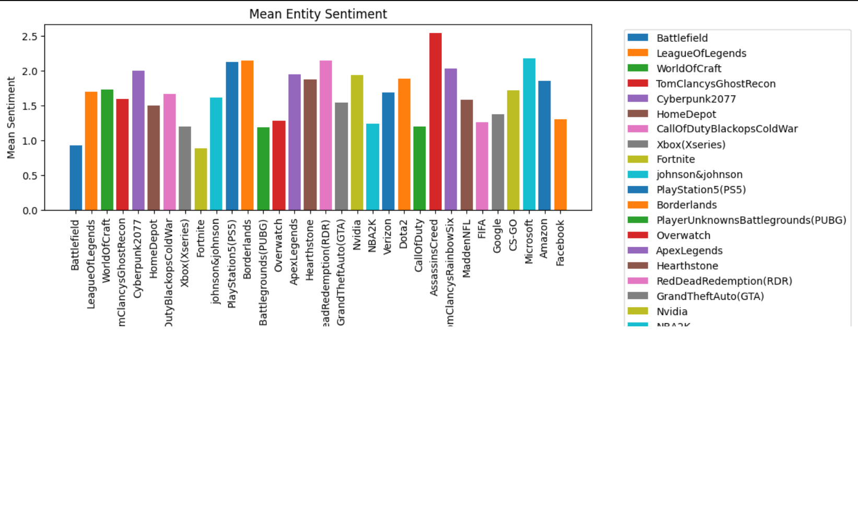
VISUALIZATION DASHBOARD Distribution of Text Length

Slide 53
Recommendations:
Based on the analysis findings, we can offer actionable recommendations to content creators or marketers to enhance engagement and satisfaction on YouTube. These recommendations could include:
1. Identifying popular topics or themes that generate positive sentiment and creating more content around them.
2. Content creators and marketers can use the TfidfVectorizer-based model(because of its higher Top-1 Classification Accuracy) to gain valuable insights into audience sentiment and tailor their strategies accordingly to enhance engagement and satisfaction on the platform.
3. Addressing common issues or concerns highlighted in negative sentiment comments to improve audience satisfaction.
4. Engaging with the audience by responding to comments, addressing feedback, and fostering a sense of community.
5. Experimenting with different content formats, styles, or delivery methods to better resonate with the audience.
6. Leveraging insights from sentiment analysis to tailor marketing strategies and promotional campaigns effectively.

Slide 54
Thank You

